Slide 1
SMART VILLAGE MANAGEMENT SYSTEM (Project Report)
Submitted by:
Department of Computer Science and Engineering Pragati Engineering College

Slide 2
ABSTRACT
The Smart Village Management System is a C++-based application designed to manage essential village data efficiently using data structures. The system focuses on handling citizen records, complaints, and resource management such as water, electricity, and waste. It uses linked lists for dynamic memory allocation and efficient data handling. The system is menu-driven and user-friendly, allowing village management authorities to store, retrieve, and update data easily. This project demonstrates the practical application of data structures in solving real-world problems related to rural administration.

Slide 3
INTRODUCTION
The Smart Village Management System is developed to digitize and simplify village administration tasks. Traditionally, village records are maintained manually, which leads to inefficiency and data loss. This system provides a structured way to manage citizen details, complaints, and resource usage.
Platform Used
Programming Language: C++
Platform: Console-based application
Data Structure: Linked Lists

Slide 4
OBJECTIVES
To maintain citizen records efficiently
To manage and track complaints
To monitor water and electricity usage
To record waste management data
To demonstrate the use of linked lists in real applications

Slide 5
REQUIREMENTS
Software Requirements
C++ Compiler (GCC / Turbo C++)
Operating System: Windows/Linux
Hardware Requirements
Minimum 512 MB RAM
Basic computer system

Slide 6
ALGORITHM
1. Start
2. Initialize all head pointers to NULL
3. Display main menu
4. Read user choice
5. If choice = 1 (Citizen)
5.1 Display sub-menu
5.2 If Add → create node → insert at beginning
5.3 If Display → traverse list → print data
6. If choice = 2 (Complaint)
6.1 Display sub-menu
6.2 If Add → create doubly linked node → insert at head
6.3 If Display → traverse → print
6.4 If Update → search by ID → update status
7. If choice = 3 (Water)
7.1 Input consumer ID and units
7.2 Calculate bill = units × 2.5
7.3 Insert into linked list
7.4 Display records

Slide 7
.
8. If choice = 4 (Electricity)
8.1 Input units
8.2 If units ≤ 100 → bill = units × 3
8.3 Else if units ≤ 300 → bill = 100 × 3 + (units − 100) × 5
8.4 Else → bill = 100 × 3 + 200 × 5 + (units − 300) × 7
8.5 Store in linked list
8.6 Display records
9. If choice = 5 (Waste)
9.1 Input waste details
9.2 Insert node into linked list
9.3 Display list
10. Repeat steps until Exit is selected
11. Stop
ALGORITHM

Slide 8
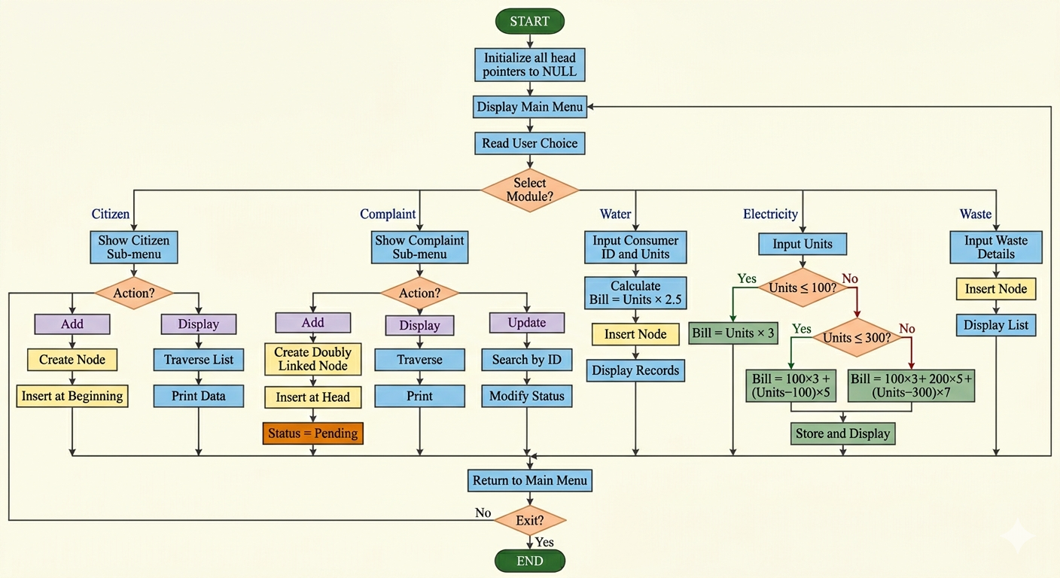
FLOWCHART

Slide 9
METHODOLOGY
The system is implemented using linked lists to allow dynamic memory allocation. Each module is designed independently:
Citizen → Singly Linked List
Complaint → Doubly Linked List
Water/Electricity/Waste → Singly Linked Lists
Operations like insertion and traversal are used to manage data efficiently. The system follows a modular and menu-driven approach.

Slide 10
PROJECT IMPLEMENTATION CODE
Citizen* citizenHead = NULL;
Complaint* complaintHead = NULL;
WaterRecord* waterHead = NULL;
ElectricityRecord* electricityHead = NULL;
WasteRecord* wasteHead = NULL;
void addCitizen() {
Citizen* node = new Citizen();
cout << "Enter ID: ";
cin >> node->id;
cout << "Enter Name: ";
cin >> node->name;
cout << "Enter Age: ";
cin >> node->age;
node->next = citizenHead;
citizenHead = node;
cout << "Citizen added\n";
}
struct WaterRecord {
int consumerId;
int units;
float bill;
WaterRecord* next;
};
struct ElectricityRecord {
int consumerId;
int units;
float bill;
ElectricityRecord* next;
};
struct WasteRecord {
int id;
string type;
int quantity;
WasteRecord* next;
};
#include <iostream>
#include <string>
using namespace std;
struct Citizen {
int id;
int age;
string name;
Citizen* next;
};
struct Complaint {
int id;
string text;
string status;
Complaint* next;
Complaint* prev;
};

Slide 11
void displayCitizens() {
if (citizenHead == NULL) {
cout << "No citizens found\n";
return;
}
cout << "\nCitizen List\n";
Citizen* temp = citizenHead;
while (temp != NULL) {
cout << temp->id << " | " << temp->name << " | " << temp->age << endl;
temp = temp->next;
}
}
void addCitizen() {
Citizen* node = new Citizen();
cout << "Enter ID: ";
cin >> node->id;
cout << "Enter Name: ";
cin >> node->name;
cout << "Enter Age: ";
cin >> node->age;
node->next = citizenHead;
citizenHead = node;
cout << "Citizen added\n";
}

Slide 12
void displayComplaints() {
if (complaintHead == NULL) {
cout << "No complaints\n";
return;
}
cout << "\nComplaint List\n";
Complaint* temp = complaintHead;
while (temp != NULL) {
cout << temp->id << " | " << temp->text << " | " << temp->status << endl;
temp = temp->next;
}
}
void addComplaint() {
Complaint* node = new Complaint();
cout << "Enter Complaint ID: ";
cin >> node->id;
cin.ignore();
cout << "Enter Text: ";
getline(cin, node->text);
node->status = "Pending";
node->prev = NULL;
node->next = complaintHead;
if (complaintHead != NULL)
complaintHead->prev = node;
complaintHead = node;
cout << "Complaint added\n";
}

Slide 13
void addWaterRecord() {
WaterRecord* node = new WaterRecord();
cout << "Enter Consumer ID: ";
cin >> node->consumerId;
cout << "Enter Units: ";
cin >> node->units;
node->bill = node->units * 2.5;
node->next = waterHead;
waterHead = node;
cout << "Water record added\n";
}
void updateComplaintStatus() {
int id;
cout << "Enter Complaint ID: ";
cin >> id;
Complaint* temp = complaintHead;
while (temp != NULL) {
if (temp->id == id) {
cout << "Enter new status: ";
cin >> temp->status;
cout << "Updated\n";
return;
}
temp = temp->next;
}
cout << "Not found\n";
}
void displayWaterRecords() {
if (waterHead == NULL) {
cout << "No water records\n";
return;
}
cout << "\nWater Records\n";
WaterRecord* temp = waterHead;
while (temp != NULL) {
cout << temp->consumerId << " | " << temp->units << " | Rs." << temp->bill << endl;
temp = temp->next;
} }

Slide 14
void addElectricityRecord() {
ElectricityRecord* node = new ElectricityRecord();
cout << "Enter Consumer ID: ";
cin >> node->consumerId;
cout << "Enter Units: ";
cin >> node->units;
if (node->units <= 100)
node->bill = node->units * 3;
else if (node->units <= 300)
node->bill = 100 * 3 + (node->units - 100) * 5;
else
node->bill = 100 * 3 + 200 * 5 + (node->units - 300) * 7;
node->next = electricityHead;
electricityHead = node;
cout << "Electricity record added\n";
}
void displayElectricityRecords() {
if (electricityHead == NULL) {
cout << "No electricity records\n";
return;
}
cout << "\nElectricity Records\n";
ElectricityRecord* temp = electricityHead;
while (temp != NULL) {
cout << temp->consumerId << " | " << temp->units << " | Rs." << temp->bill << endl;
temp = temp->next;
}
}

Slide 15
void addWasteRecord() {
WasteRecord* node = new WasteRecord();
cout << "Enter ID: ";
cin >> node->id;
cout << "Enter Type: ";
cin >> node->type;
cout << "Enter Quantity: ";
cin >> node->quantity;
node->next = wasteHead;
wasteHead = node;
cout << "Waste added\n";
}
void displayWasteRecords() {
if (wasteHead == NULL) {
cout << "No waste records\n";
return;
}
cout << "\nWaste Records\n";
WasteRecord* temp = wasteHead;
while (temp != NULL) {
cout << temp->id << " | " << temp->type << " | " << temp->quantity << endl;
temp = temp->next;
}
}

Slide 16
int main() {
int choice, op;
do {
cout << "\nMain Menu\n";
cout << "1 Citizen\n2 Complaint\n3 Water\n4 Electricity\n5 Waste\n6 Exit\n";
cin >> choice;
switch (choice) {
case 1:
cout << "1 Add\n2 Display\n";
cin >> op;
if (op == 1) addCitizen();
else displayCitizens();
break;
case 2:
cout << "1 Add\n2 Display\n3 Update\n";
cin >> op;
if (op == 1) addComplaint();
else if (op == 2) displayComplaints();
else updateComplaintStatus();
break;

Slide 17
case 3:
cout << "1 Add\n2 Display\n";
cin >> op;
if (op == 1) addWaterRecord();
else displayWaterRecords();
break;
case 4:
cout << "1 Add\n2 Display\n";
cin >> op;
if (op == 1) addElectricityRecord();
else displayElectricityRecords();
break;
case 5:
cout << "1 Add\n2 Display\n";
cin >> op;
if (op == 1) addWasteRecord();
else displayWasteRecords();
break;
case 6:
cout << "Exiting\n";
break;
default:
cout << "Invalid choice\n";
}
} while (choice != 6);
return 0;
}

Slide 18
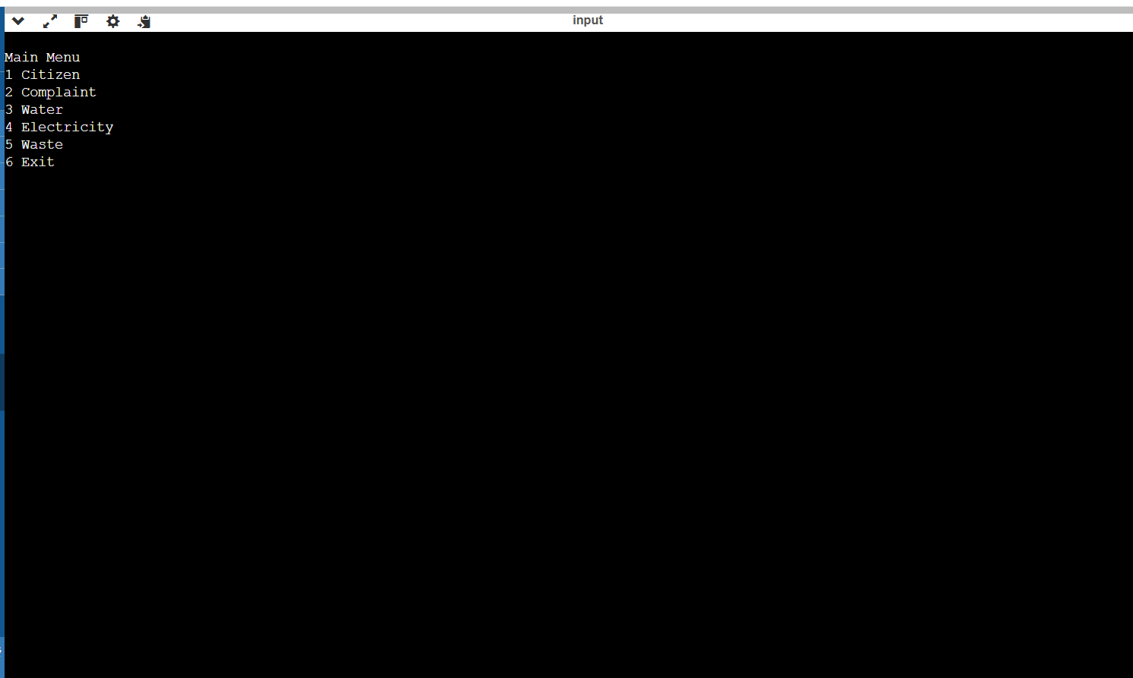
RESULTS (OUTPUT SCREENSHOTS)

Slide 19
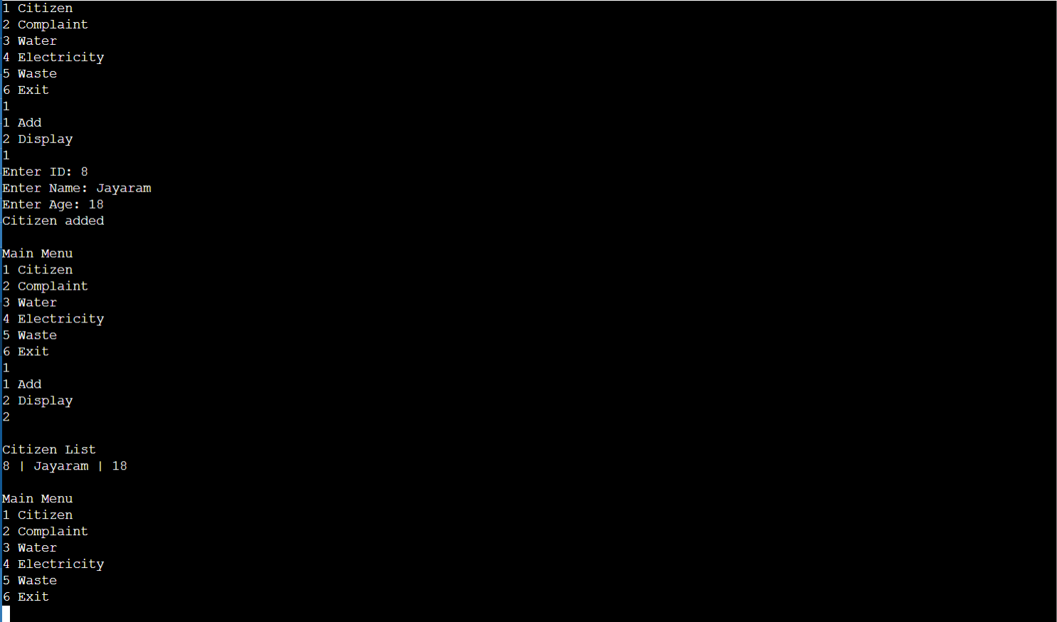

Slide 20
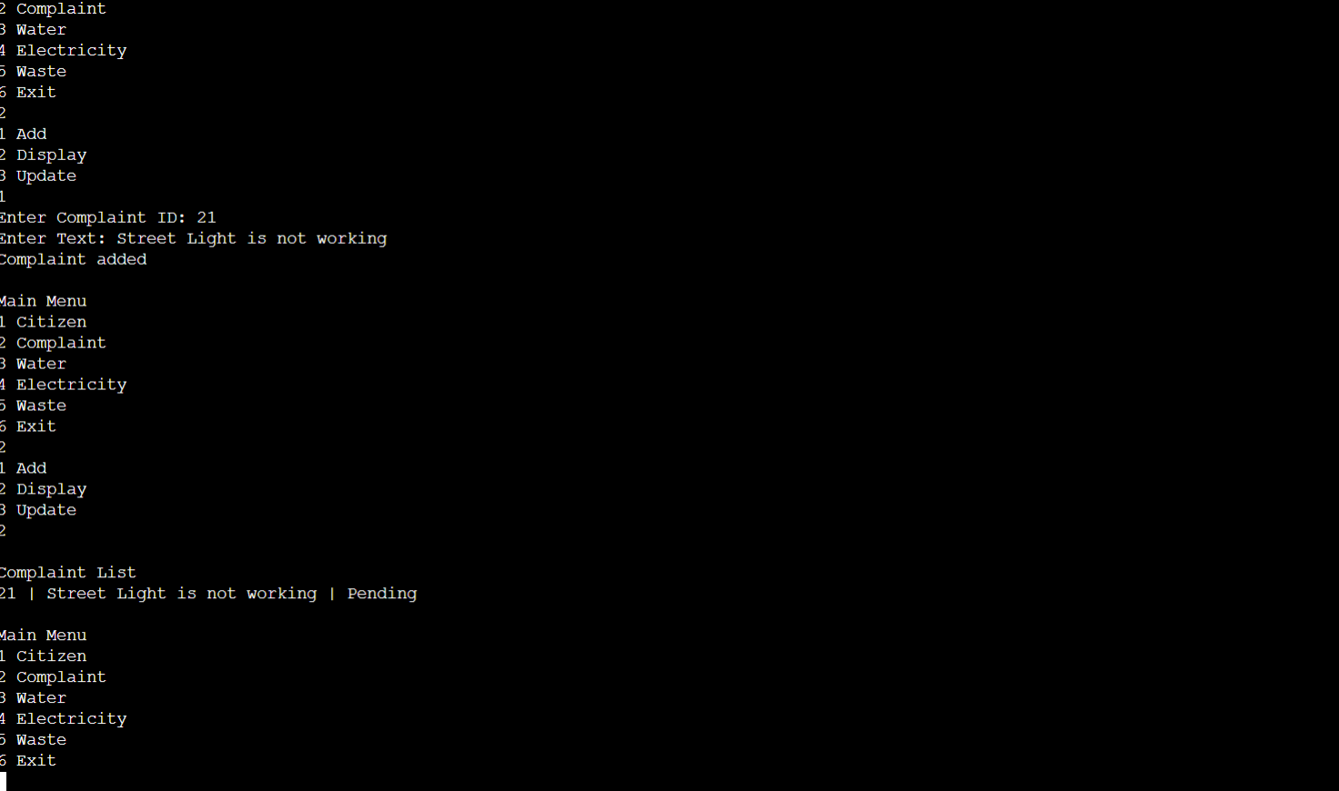

Slide 21
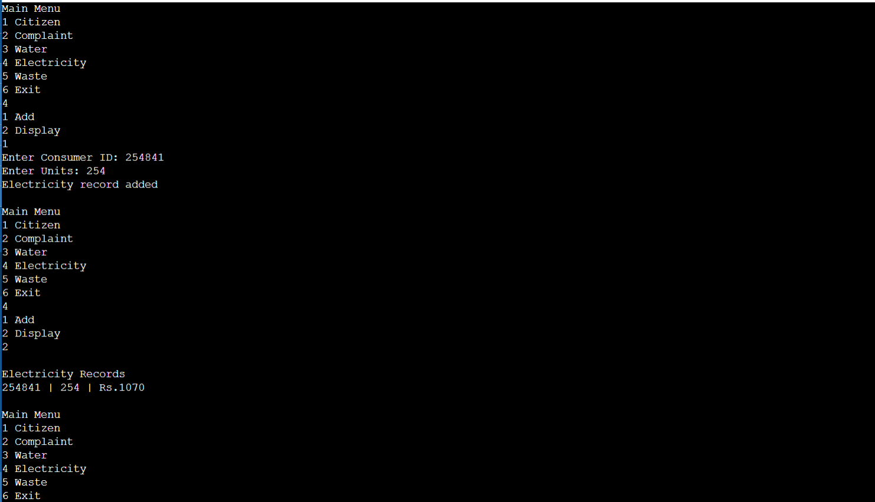

Slide 22
FUTURE SCOPE
This project can be further improved by:
Adding file handling for permanent storage
Creating a graphical user interface
Developing a web/mobile version
Adding login authentication system

Slide 23
REFERENCES
Bjarne Stroustrup, The C++ Programming Language, 4th Edition, Addison-Wesley, 2013.
E. Balagurusamy, Object Oriented Programming with C++, 8th Edition, McGraw Hill Education, 2020.
Mark Allen Weiss, Data Structures and Algorithm Analysis in C++, 4th Edition, Pearson, 2014.
Seymour Lipschutz, Data Structures with C, Schaum’s Outline Series, McGraw Hill, 2011.
Robert Lafore, Data Structures and Algorithms in C++, 2nd Edition, Sams Publishing, 2002.
Narasimha Karumanchi, Data Structures and Algorithms Made Easy, CareerMonk Publications, 2016.
GeeksforGeeks, “Linked List Data Structure,” Available: https://www.geeksforgeeks.org
TutorialsPoint, “C++ Programming and Data Structures,” Available: https://www.tutorialspoint.com

